Slide 1

Introduction to linear models
Of course I’m $Normal$

Slide 2
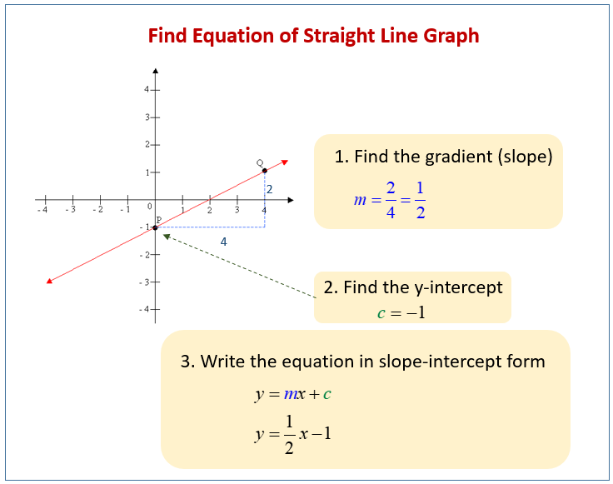

Stats: making the simple seem complicated
Statistics is all about finding associations
  When temperature increases, what happens to survival?
  What is the average number of kittiwakes in Site A and Site B?
The maths is pretty simple
  Intercepts and slopes
  Or multiple averages
Some form of:
$$y=mx+c$$

Slide 3
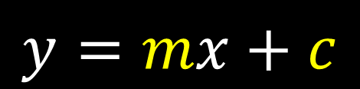
Statistics and data
$$y=mx+c$$
Continuous (e.g. height)
Observed
Grouped
(e.g. eye colour)
Data
Unobserved
“Parameter”

Slide 4

Statistics and data
$$y_{i}=β_{0}+β_{1}×x_{i}$$
Continuous (e.g. height)
Observed
Grouped
(e.g. eye colour)
Data
Unobserved
“Parameter”

Slide 5
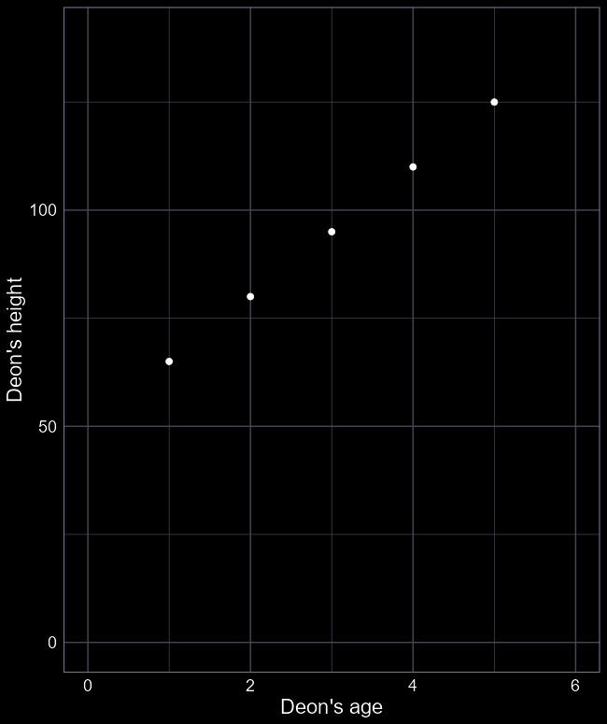

Doing “stats” by hand
Your straight-line equation:
$$y_{i}=β_{0}+β_{1}×X_{i}$$
  $y_{i}$ = Deon’s height
  $X_{i}$ = Deon’s age
  $β_{0}$ = y-intercept
  (I was $β_{0}$ cm tall when I was born)
  $β_{1}$ = Slope
  (aging 1 year increased my height by $β_{1}$ cm)
Observed data
Unobserved data
$i$ is an index; e.g. if $i=1$ then this is the first observation

Slide 6
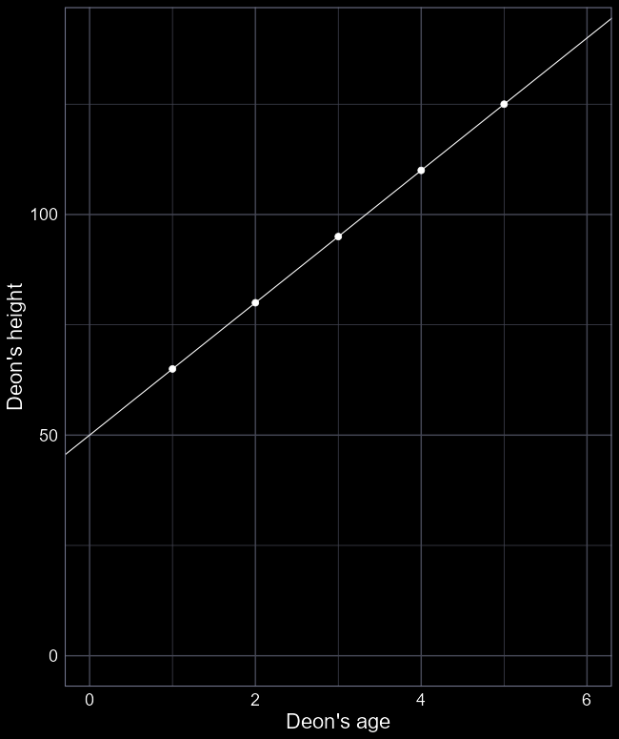



“Stats” by hand
Deon’s height = $β_{0}+β_{1}×$ Deon’s age
What is $β_{0}$?
Imagine a line extending down to 0 years old.
$β_{0}$ = 50 cm at 0 years old
What is $β_{1}$?
How much did I grow in one year?
$β_{1}$ = 15 cm per year
We now have an association.
We can use the equation to make predictions:
How tall was I at 6 years old?
Height = 50 + 15 $×$ 6 = 140 cm
How tall will I be when I am 120 years old?
Height = 50 + 15 $×$ 120 = 1850 cm
Be very careful when predicting
75 cm
60 cm
$$β_{1}=15 cm per year$$
$$β_{0}=50 cm$$

Slide 7
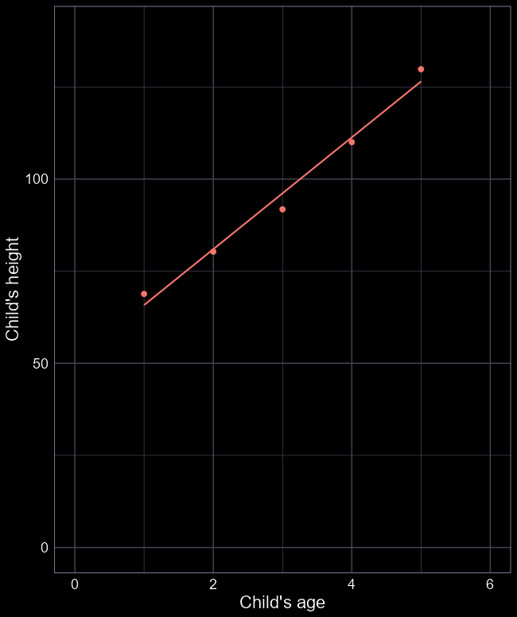
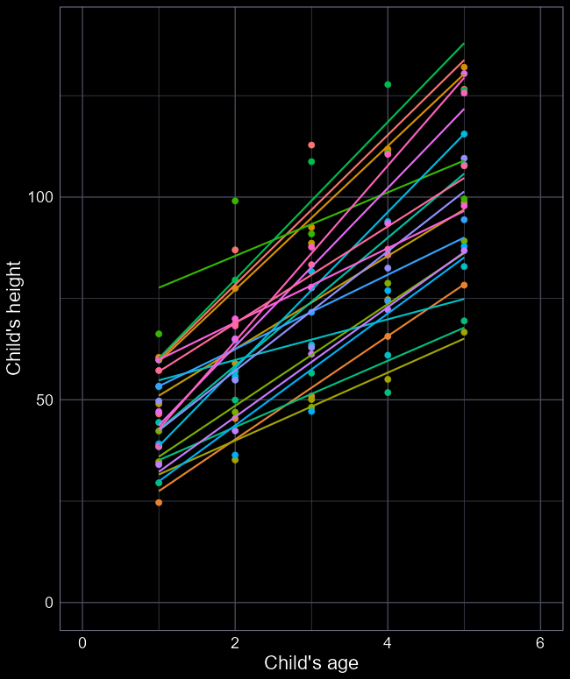
More realism
The real world is not perfect
Our predictions (i.e. the line) are never perfect
Even the same individuals have variation
  E.g. growth spurts
Different individuals are not the same
  And can vary in their own way
But we want to describe the general relationship

Slide 8
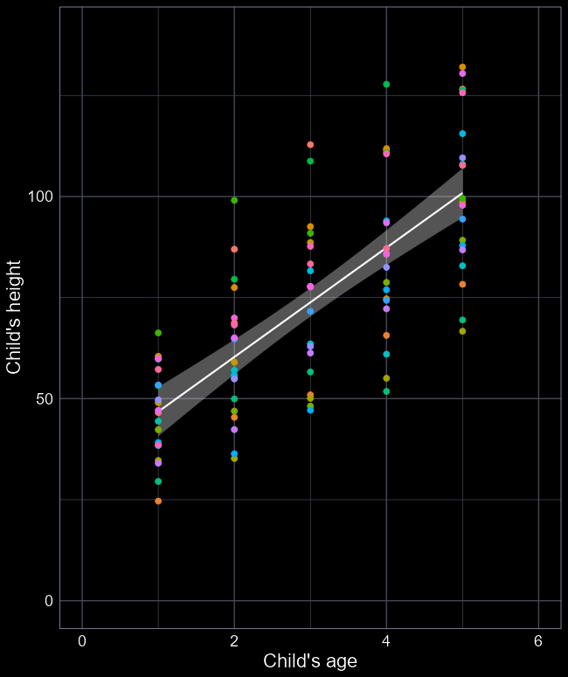

What stats does
Statistics not only deals with variation but incorporates it
Cuts through the noise to show signal
Ideally, finds the relationship we want to understand
Here:
  $\hat{β_{0}}=36.5 cm$
  $\hat{β_{1}}=14.8 cm per year$

Slide 9
Distributions

Slide 10
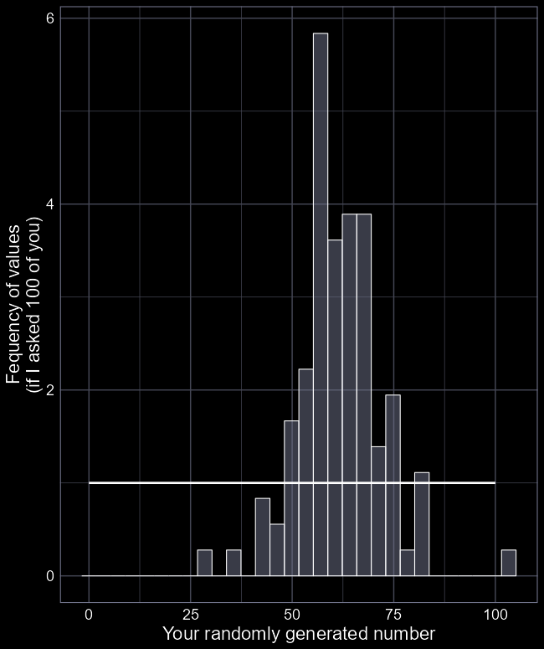
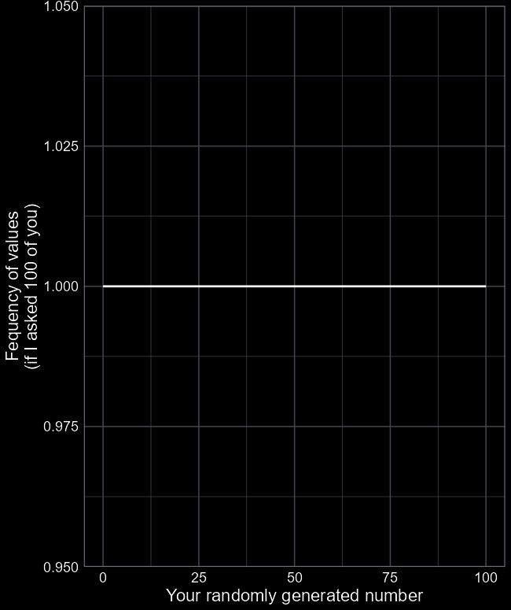
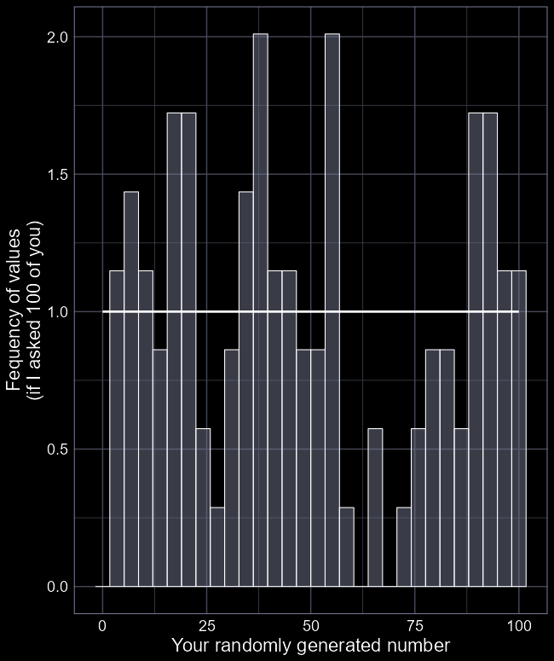

Distributions
Imagine a random number between 0 and 100
Each value (should) have an equal probability of being selected
But in the real world, we have randomness (“stochasticity”)
To describe that random number generator, we can write:
$$Uniform(0, 100)$$
But what if the world isn’t that simple?

Slide 11
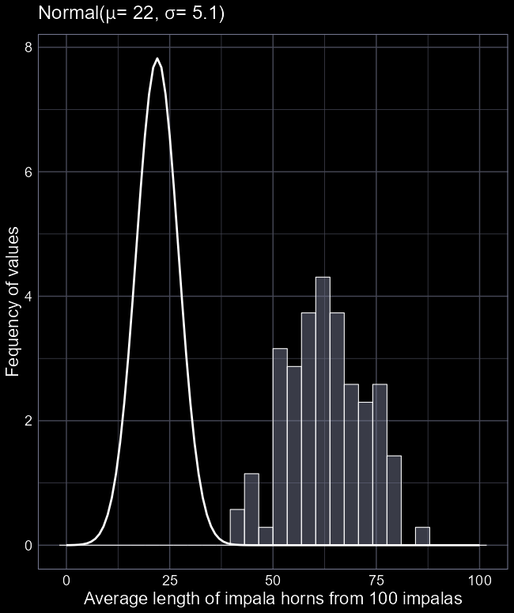
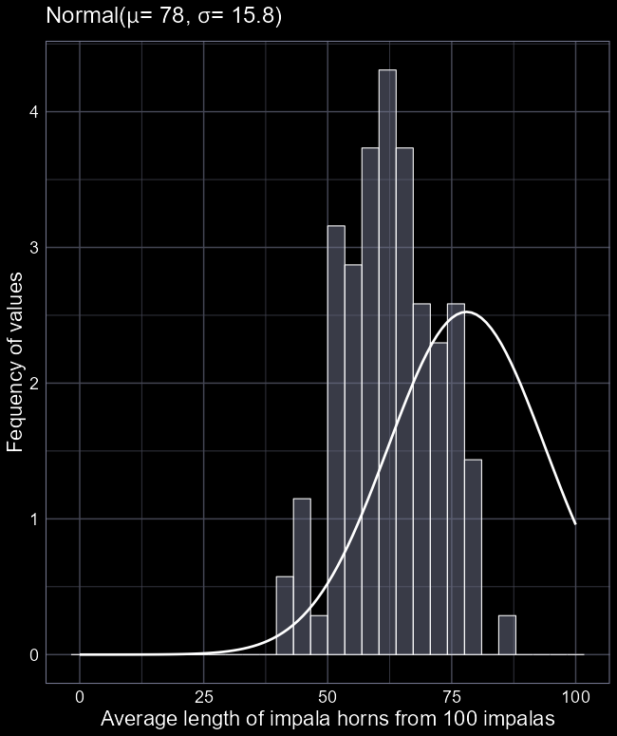
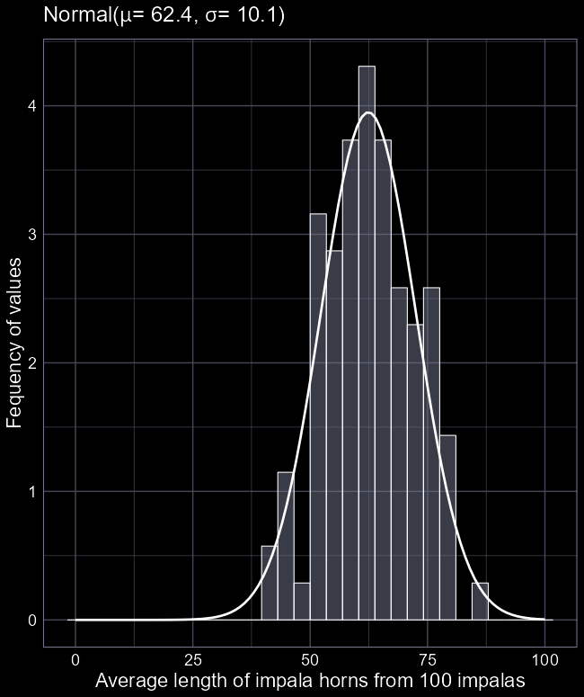


$Normal$ distribution
The $Uniform$ distribution isn’t very useful for explaining the world
The $Normal$ distribution is the first “major” distribution people learn
Described with two “parameters”
  The mean ($μ$)
  And the standard deviation ($σ$)
We just need to figure out which values for mean and standard deviation work best with our data

Slide 12
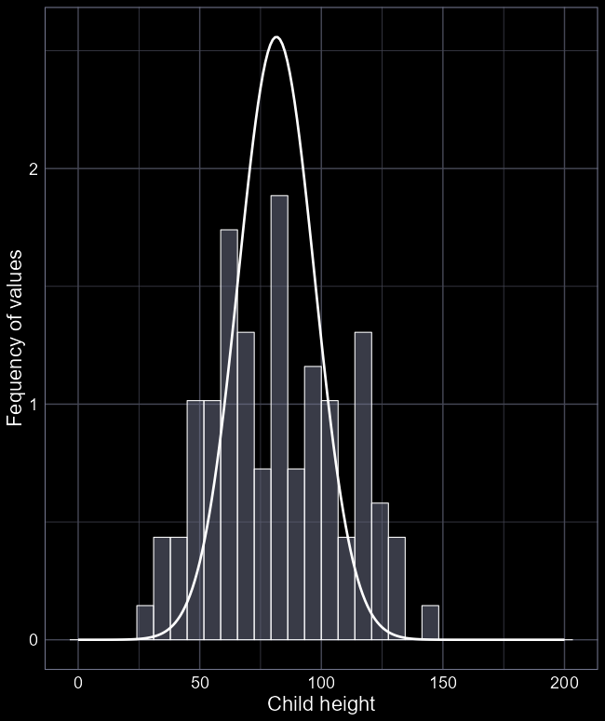
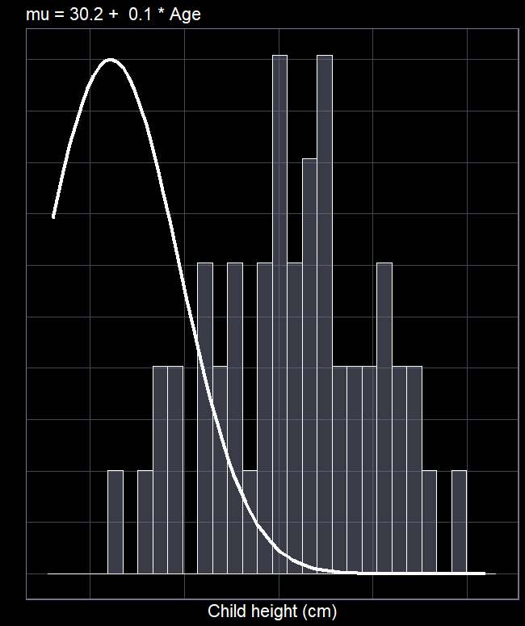

Goal of statistics
We want to tweak the distribution such that the idealised distribution overlaps the real data
How do we tweak the distribution?
Change the mean ($μ$)
How do we change $μ$?
$μ_{i}=β_{0}+β_{1}×X_{i}$
For the child height example, we said:
  $μ_{i}=36.5+14.8×Age_{i}$

Slide 13

Goal of statistics
More formally, we’d write:
$$Height_{i}∼Normal\left(μ_{i}, σ_{i}\right)$$
$$μ_{i}=β_{0}+β_{1}Age_{i}$$
Where:
$Height_{i}$ is the height of child $i$
“$\sim$” means “generated according to…”
$Normal$ is the distribution we assume generated the $Height$ values
$μ_{i}$ is the average $Height$ we would expect for child $i$
$σ_{i}$ is the standard deviation in $Height$ we expect for child $i$
Where the average ($μ$) is:
  $β_{0}$ (height at age 0)
  $β_{1}$ (how many cm a child grows each year)

Slide 14
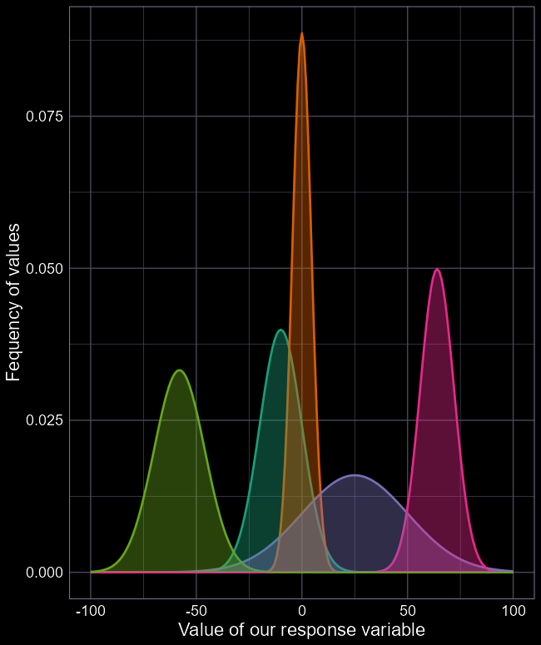


The $Normal$ distribution
When using a $Normal$ distribution a big assumption we make is:
  The average and range can be anywhere from negative infinity to positive infinity
  Meaning the model can predict negative values
    E.g. children could be -5 cm tall
    Not a problem so long as mean and SD are “far” from zero
If your model predicts values that are biologically impossible, consider changing distribution

Slide 15
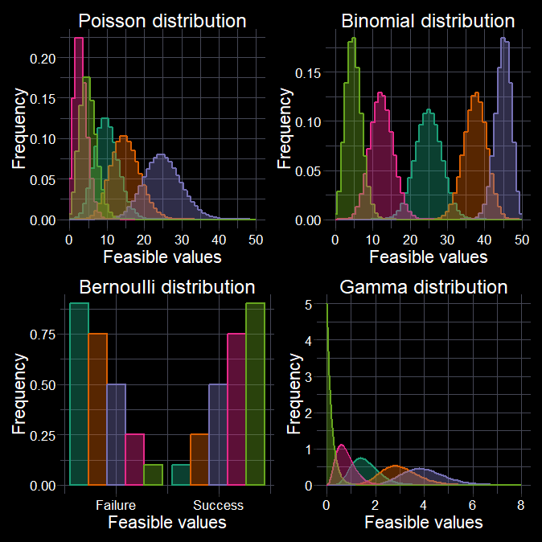

Many more fish in the sea
Lots of different distributions available
Switching to them is “easy”
  Doing so leads to Generalised Linear Models (GLMs)
We don’t do GLMs in this course
Just be aware that you are not limited to the $Normal$ distribution

Slide 16
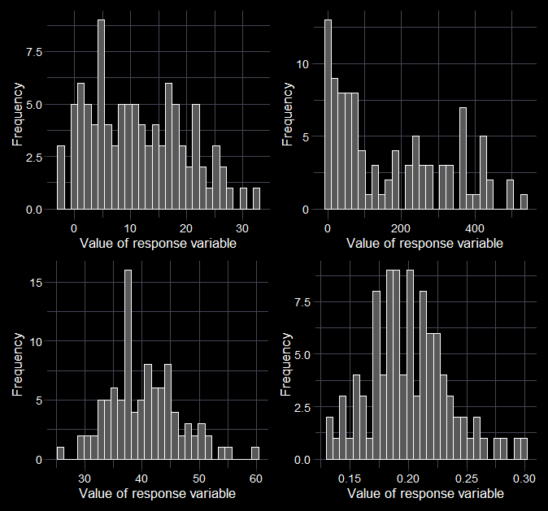




Beware the histomancer
Don’t plot histograms of your response to “determine” the distribution.
Think about the data:
  What kind of values could I measure?
  Are there limits to the values I could measure?
    (And am I close to those limits?)
  Of the distributions I know of, which one best describes my data?
$$Normal$$
$$Normal$$
$$Poisson$$
$$Beta$$

Slide 17
How much coffee do you drink?

Slide 18

From a culture where drinking coffee in the morning is normal?
Parents drink coffee
Did you drink coffee yesterday?
Watched TV where mature characters drank coffee?
Was nostalgic for grandparent’s coffee?
Wanted to emulate characters?
Grandparent used to grind coffee by hand?
Drinks tea instead of coffee?
Grandparent’s room had butterflies in the wallpaper?
Believe drinking coffee helps with a hangover?
Saw a butterfly this morning?
Is hungover?

Slide 19


What is the average number of coffees you drink in a year?
Boring question. Who cares?
The response will be a value (e.g. 522.6).
Given your answer, the more interesting question is why do you drink that many?
For each of us, there is some unknown average number of coffees, that we drink in a year,
which is determined by some set of
explanatory variables.
$$y_{i}∼Normal(μ_{i}, σ_{i})$$
$$μ_{i}=Xβ$$

Slide 20




Stochastic and deterministic
$$y_{i}∼Normal\left(μ_{i}, σ_{i}\right)$$
$$μ_{i}=stuff_{i}$$
This is the stochastic (i.e. “randomness”) element of the model
By using the $Normal$ distribution, we tell the model what type of response values are sensible, given we don’t expect perfect fit
E.g. the linear predictor ($μ$) might suggest you drink 528.6 coffees in a year
  But not all people will drink exactly 528.6 coffees
This is the deterministic element of the model
We decide what goes into the deterministic element
  E.g. I think $y$ happens because of $X$
E.g. I drink an average of 781.3 coffees a year because I was heavily influenced by media growing up
  But someone who didn’t consume the same media as me will probably drink less

Slide 21
Uses and risks of modelling

Slide 22


First amongst equals
Three broad purposes of statistics:
Causal inference
Prediction
Descriptive
Who do you think won the 2021 Japanese election?
LDM have won $\frac{20}{21}=95\%$ (95% chance to win 2021).
$$Result_{i}∼Distribution\left(θ_{i}\right) \\ g(θ_{i})=β_{1}+β_{2}×{Red}_{i}$$
Linear models and GLMs can do all three
The model does not know it’s purpose, only you do.

Slide 23

Monkey’s paw
The Monkey’s Paw is a short story from 1902 by W. W. Jacobs.
A married couple come into possession of a wish granting monkey’s paw. They wish for money to buy a house. The husband goes to work the next morning but dies on the job. The wife gets his life insurance; enough to buy a house.
Relevance to stats:
Models will (almost) always answer your question. Just because you get an answer, doesn’t mean it’s the truth. In stats, you will rarely know if you have suffered the Monkey’s Paw.

Slide 24
Your key assumptions
(in order of importance)
Validity
  Meaning: Your data can answer your research question
  If broken: Monkey’s paw
    You’re not answering the question you think you are
  E.g.: Measuring test scores does not measure intelligence
  Of concern: Always
Representativeness
  Meaning: Your data adequately represents the “population” you want to understand
  If broken: Monkey’s paw
    You’re not describing the population you think you are
  E.g.: Polling Xbox players who they will vote for in an election
  Of concern: Always
Additivity
  Meaning: The response is simply the result of adding up the influence of the predictor variables
  If broken: Monkey’s paw
    Answer is too simplistic
  E.g.: Height does increase with age linearly
  Of concern: Almost always
Linearity
  Meaning: Deterministic element is a linear function of your explanatory variables
  If broken: Monkey’s paw
    Answer is too simplistic
  E.g.: Height does increase with age linearly
  Of concern: Almost always

Slide 25

Your key assumptions
(in order of importance)
Independence of errors
  Meaning: We have independent observations
  If broken: Monkey’s paw
    Overly confident in results
  E.g.: We measure the height of one family to estimate average human height
  Of concern: When analysing temporal, spatial, or hierarchical data
Equal variance of errors
  Meaning: The randomness is handled by the distribution
  If broken: Monkey’s paw
    Results do not generalise
  E.g.: More than just age influences height
  Of concern: When making predictions (and when using P-values/NHST)
Normality of errors
  Meaning: The difference between what the model thinks, and reality is broadly $Normally$ distributed
  If broken: Monkey’s paw
    Overly confident in results
  E.g.: We measure the height of one family to estimate average human height
  Of concern: Only relevant if attempting to predict individual data points.

Slide 26
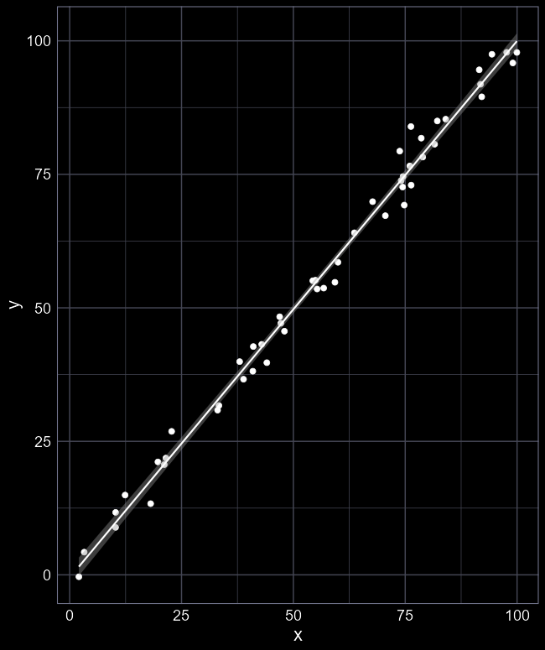
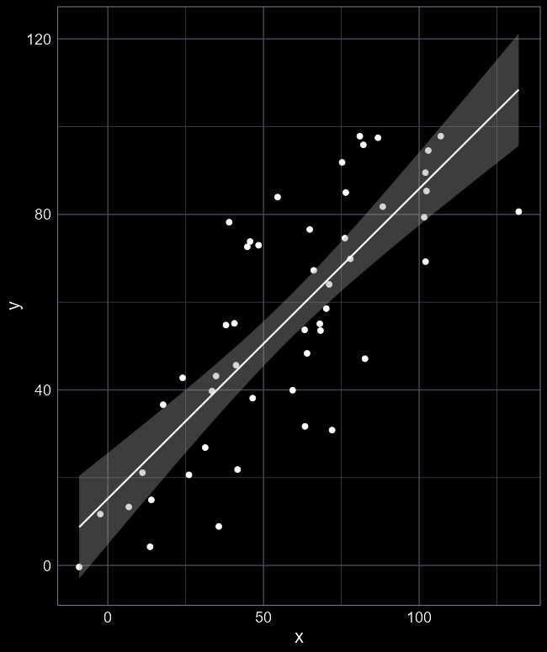
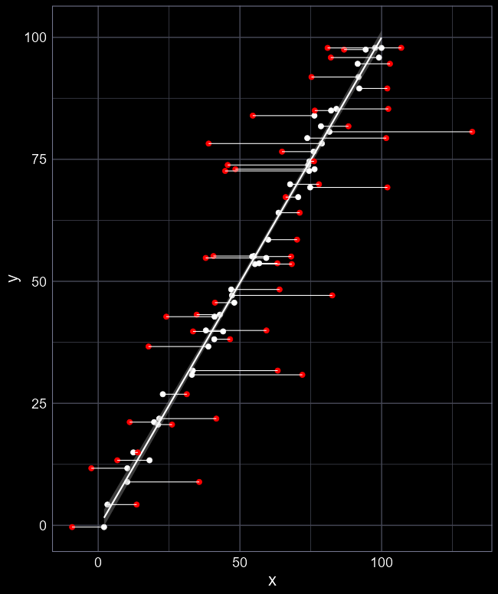
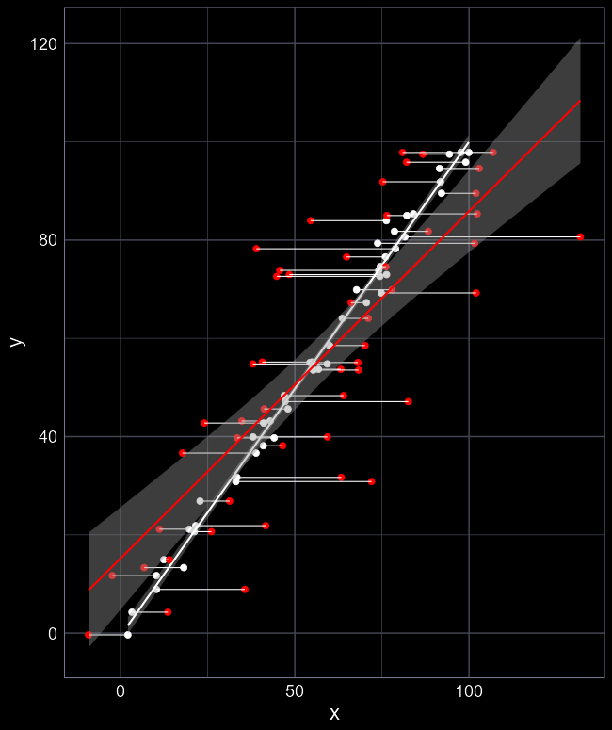
Validity
Often caused by measurement error
Measuring data accurately often quite difficult
Results is systematic bias
Almost always underestimating relationship
Can be accounted for in models but cannot be “diagnosed” from an existing data

Slide 27
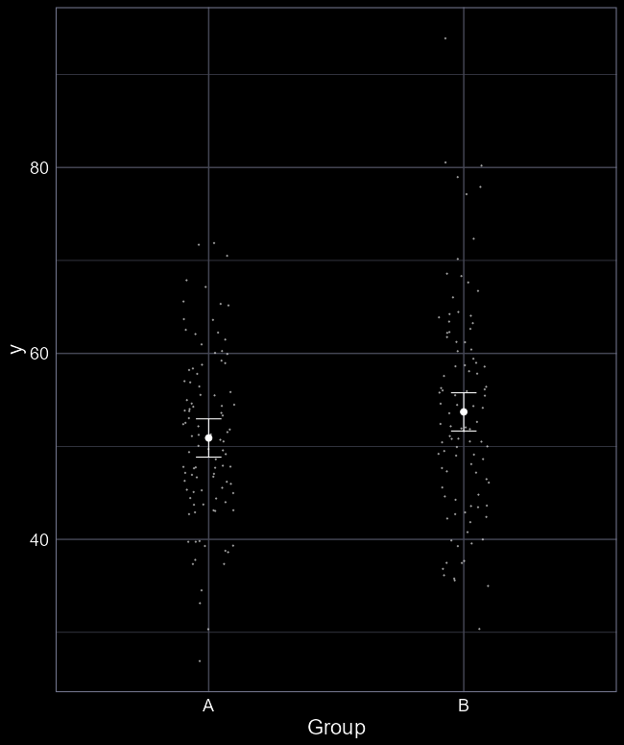
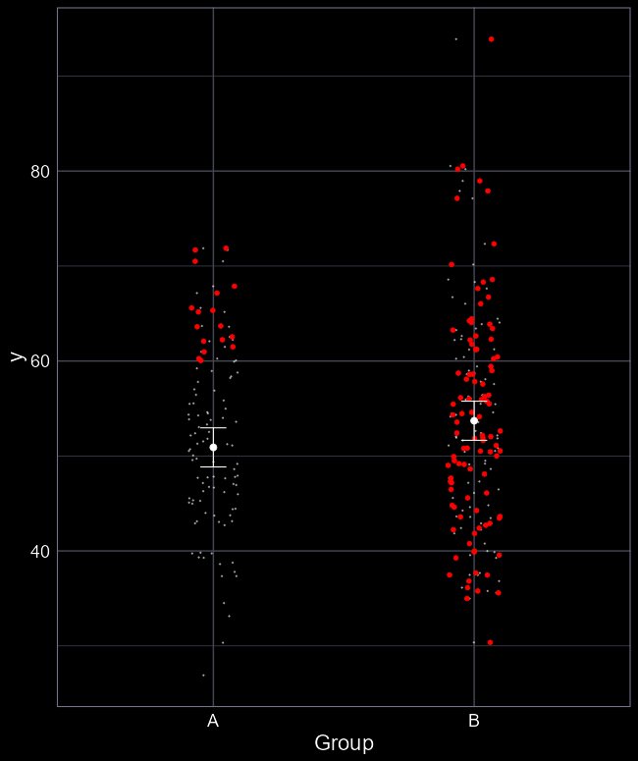
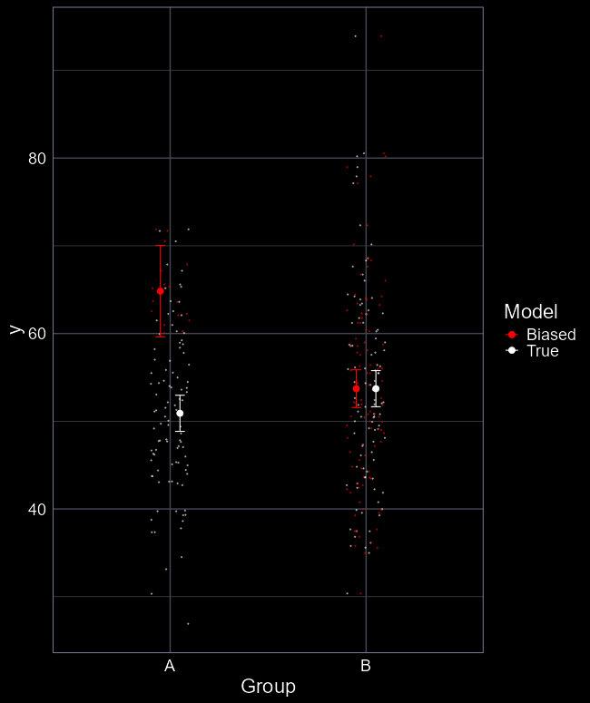
Representativeness
Often caused by poorly thought out study/experimental design
Obscures the true relationship
The data does not represent the truth
Leading us to become biassed
Can be accounted for in models but cannot be “diagnosed” from an existing data

Slide 28
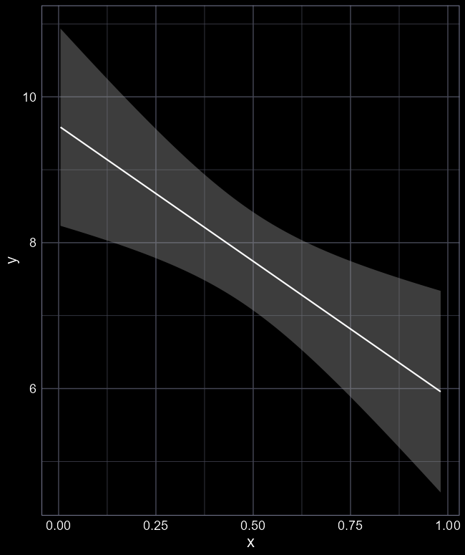
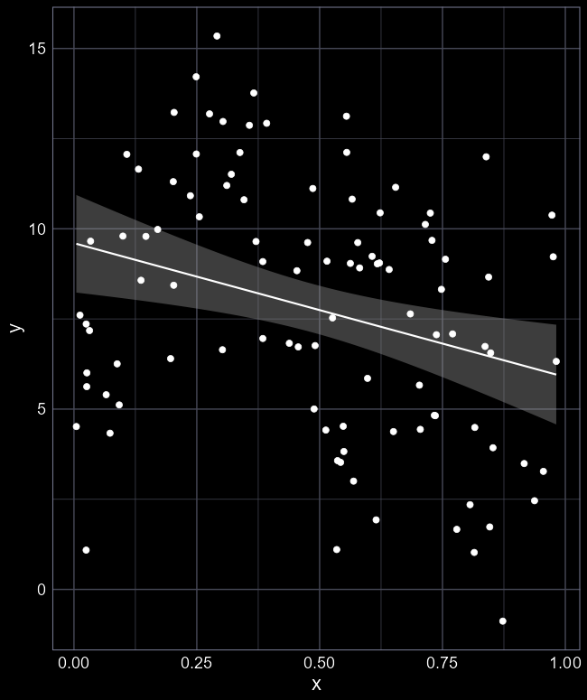
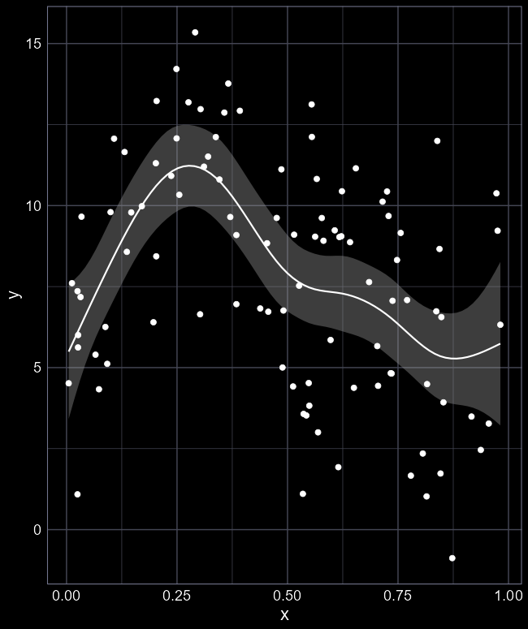
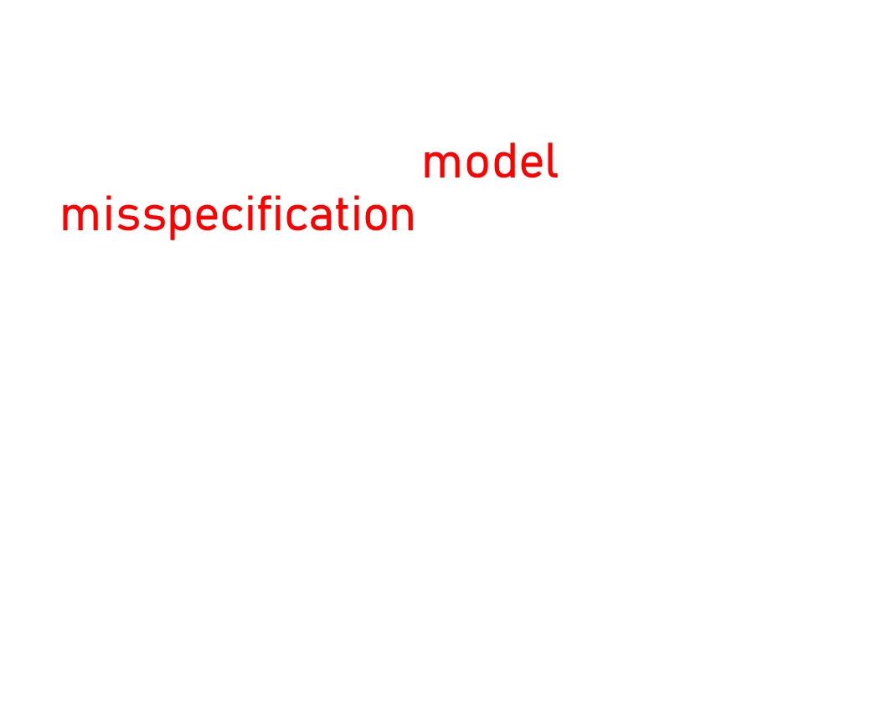
Additivity & Linearity
Often caused by model misspecification
  I.e. $μ=β_{0}+β_{1}X$ when alternative should be used
Fit can look fine but doesn’t capture the data well at all
Leads to overly simplistic and flawed inference

Slide 29
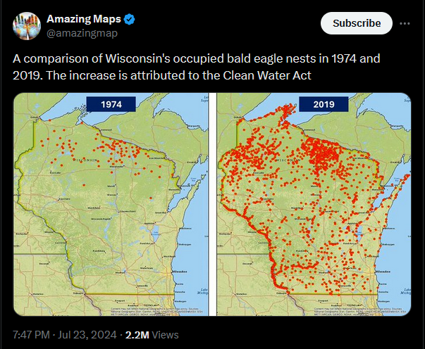
Which assumptions do we make here?
Validity
  Safe to assume people were as good at detecting eagles in 1974 as in 2019?
Representativeness
  Safe to assume it wasn’t just a handful of bird watchers in 1974 surveying the north?
Additivity
  Safe to assume “recovery” was just because of Clean Water Act?
Linearity
  Safe to assume growth was linear, not e.g. exponential?
Independent errors
  Are observations next to each in space, and over time, independent?
Equal variance
  Can only check once model has been fit
Normality of residuals
  Can only check once model has been fit

